Slide 1


Benemart Fashion E-Commerce Website
Welcome to the presentation on Benemart, a modern fashion e-commerce platform developed using PHP and MySQL.
by Prabhat Kumar

Slide 2
Developed using PHP and MySQL
PHP
MySQL
Chosen for its flexibility and ease of use for web development.
Chosen for its reliability and efficient database management capabilities.

Slide 3
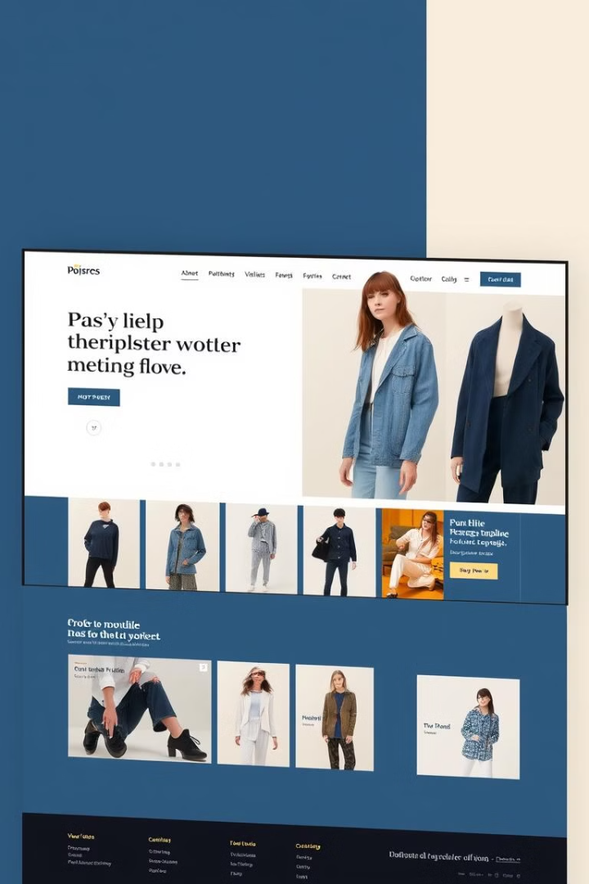
Overview of Benemart
1
Mission
2
Vision
To provide a seamless online shopping experience for fashion enthusiasts.
To be the leading destination for trendy and affordable fashion online.

Slide 4

Purpose and goals of the project
Accessibility
Convenience
To make fashionable clothing readily available to a wider audience.
To offer a user-friendly platform for browsing and purchasing.
Growth
To establish a sustainable and scalable e-commerce business.

Slide 5
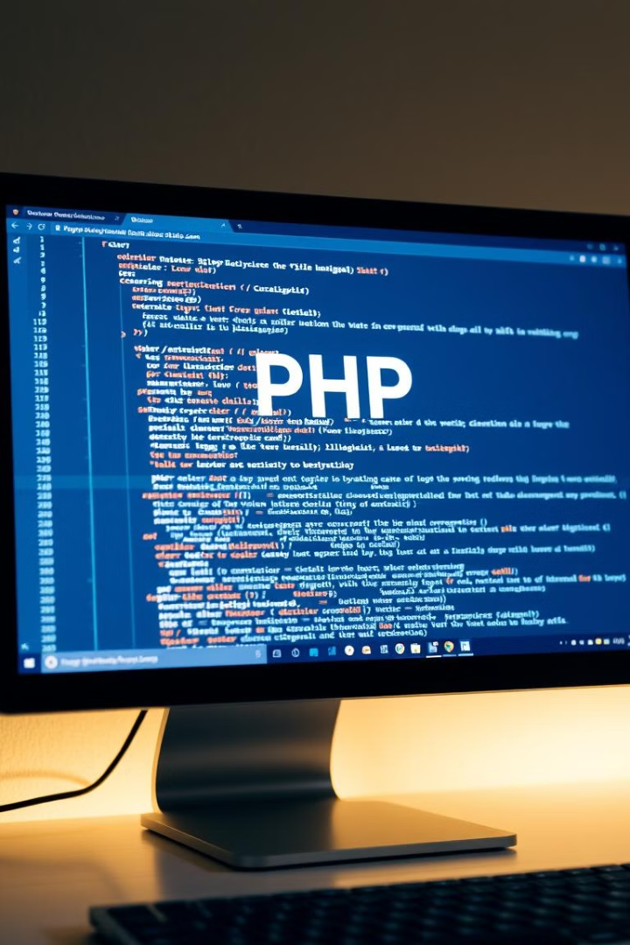



Why PHP was chosen for development
Open Source
PHP is free to use and modify, reducing development costs.
Extensive Community
Large online community provides support, resources, and libraries.
Dynamic Content
Enables creating interactive features for a dynamic user experience.

Slide 6

Target audience
Young Adults
Fashion-conscious individuals
Value-driven shoppers

Slide 7
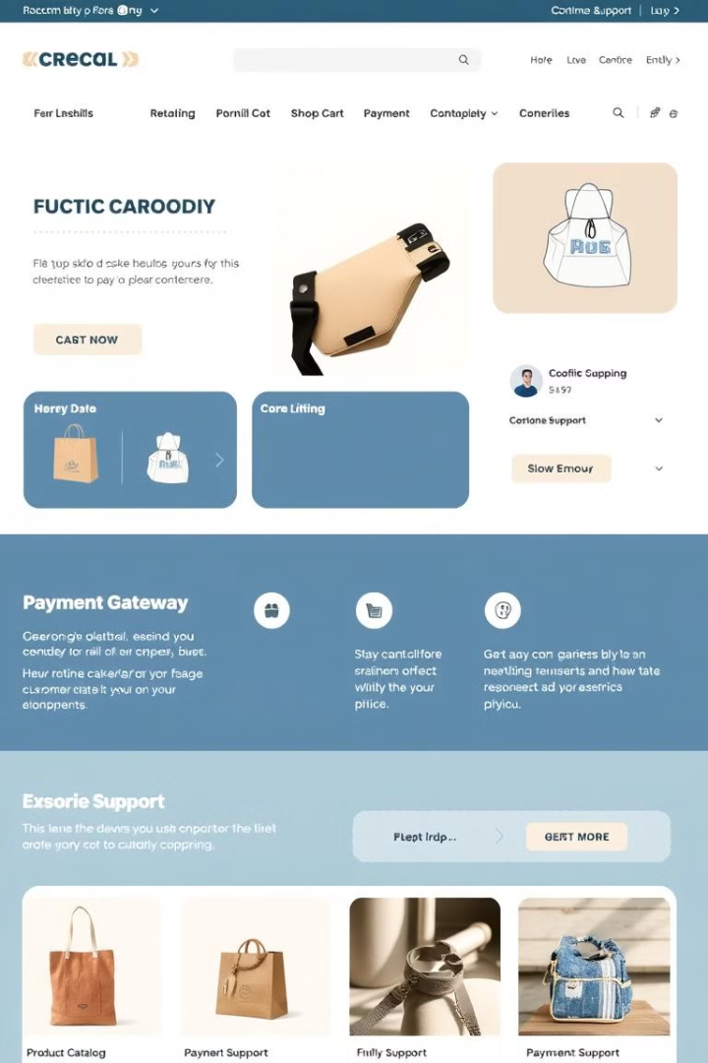




Key features of the website
Search Functionality
Shopping Cart
Allows users to find specific items easily.
Enables users to store items before purchase.
Secure Payment Gateway
Customer Support
Offers assistance and resolution for any issues.
Provides a secure and convenient payment experience.

Slide 8

Conclusion and future plans
1
Continued Development
Add new features and enhance existing ones to improve user experience.
2
Marketing and Promotion
Expand the reach of the platform through digital marketing and social media.
3
Expansion
Introduce new product categories and expand to new markets.

